Slide 1
Requirements Management with Use Cases
Module 8
Managing Changing Requirements

Slide 2
Course Outline
0 - About This Course
1 - Best Practices of Software Engineering
2 - Introduction to RMUC
3 - Analyzing the Problem
4 - Understanding Stakeholder Needs
5 - Defining the System
6 - Managing the Scope of the System
7 - Refining the System Definition
8 - Managing Changing Requirements
9 - Requirements Across the Product Lifecycle

Slide 3
Managing Changing Requirements - Overview
Problem
Problem Space
Needs
Solution Space
Features
Traceability
The Product To Be Built
Software
Requirements
Test Procedures
Design
User Docs
Notes:
In this module we will discuss various ways to manage changing requirements.
An iterative process allows us to refine the model in smaller increments at each iteration and helps us maintain control of the changes throughout the product lifecycle.
Use this slide to explain where we are in the class:
In this module we will discuss some ways to handle changing requirements.
In an iterative process we refine the model in each step. Structuring the use-case model will sometimes help, but stress that this is not necessary and should *not* be attempted too early!

Slide 4
Why Do Requirements Change?
We failed to ask the right people the right questions at the right time
The problem being solved changed
The users changed their minds or their perceptions
The external environment changed
We failed to create a process to help manage change
Our understanding of the problem improved
Notes:
Module 8- Managing Changing Requirements
RMUC Instructor Notes
Has anyone ever worked on a project where there were *no* changes in the requirements from the initial agreement through the end of the project?
Ask the students to share experiences of when they have seen requirements change in a project.
Has anyone ever worked on a project where there were *no* changes in requirements from initial agreement through the end of the project?

Slide 5
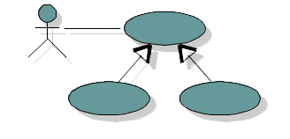
Requirements Management Architecture
Notes:
Module 8- Managing Changing Requirements
RMUC Instructor Notes
Here is architecture that may be used for organizing documents and maintaining project requirements and attributes in a central repository. This repository can be used for collecting metrics, generating reports, and answering queries relating to requirements within the project.

Slide 6
What About Metrics for Requirements Management?
What types of questions to ask?
  How many requirements do we have?
  What percentage are in the baseline?
  What critical requirements haven’t been implemented?
  What resources are needed to put in this new feature?
  What’s the estimated cost of the proposed changes?
  How many changes since the last customer review?
    Who authorized the changes?
    What’s the impact on test?
Handout
WP: “Metrics for
Requirements Management”
Notes:
Module 8- Managing Changing Requirements
RMUC Instructor Notes
The white paper Metrics for Requirements Management in the Handouts has more discussion about requirements metrics for project management.
These questions are examples. Bring up other examples, and you can also ask the students for other examples of metrics they use.

Slide 7
What Is Requirements Traceability?
Business Needs
drive
Customer Needs
which drive
User Needs
which demand
Product Features
that drive
Software Requirements
that we developers
Implement and Test
E . Magaziner ‘96
Notes:
Here are some of the different levels of requirements we may wish to trace.

Slide 8
Why Use Requirements Traceability?
Assure quality
  Verify the implementation fulfills all requirements
  Verify the application does only what was intended
Help manage change
  Understand the impact of a change
  Find related requirements
Handout
WP: “Traceability Strategies
for Managing Requirements
with Use Cases”
Notes:
Module 8- Managing Changing Requirements
RMUC Instructor Notes
One of the keys to effective change management of requirements is traceability of requirements to other project elements.
Requirements traceability is a proven technique for assuring quality. The technique is recommended by standards and assessment groups such as IEEE and CMM. It is also mandated by many organizations, such as the Department of Defense (DOD), and the Food and Drug Administration (FDA)
See the white paper Traceability Strategies for Managing Requirements with Use Cases (in the Student Handout book) for a discussion of traceability options.
Traceability helps verify that the implemented software fulfills all requirements because we can trace from each requirement to the implementation objects that implement it, and to the tests that test it. If some requirement does not trace to an implementation object, then the requirement has not been implemented.
Traceability helps verify that an application does only what it was intended to do since we can trace from each implementation object back to the requirements it satisfies.

Slide 9
Determine Your Requirement Traceability Strategy
Needs
Vision
Features
Software
Requirements
Stakeholder
Requests
Use-Case
Model
Supplementary
Specification
Design Model
End-User Documentation
Materials and
Training Materials
Test Model
Notes:
The first step is to establish your requirements structure and the relationship of different types of requirements to each other.

Slide 10
Establish Traceability Paths
1. Trace top-level requirements into detailed requirements
2. Trace requirements into design
3. Trace requirements into test procedures
4. Trace requirements into user documentation plan
Product
Requirements
(Features)
Req A
1
Detailed
Requirements
(Use Cases)
Req B
2
3
4
Design
Test
User Docs
Software Design Descriptions
Object Models
Test Suites
Documentation Plan
Notes:
Based on this structure, we then need to set up traceability links between all associated requirements or other project elements.

Slide 11
Link Feature to Use Case
Vision Document
FEAT10:The recycling machine will allow the addition of new bottle types.
[UC4: Use Case “Add New Bottle Type”]
New kinds of bottles can be added to the machine by starting it in ‘learning mode’ and inserting 5 samples …
Verifies that all lower level (derived requirements) are consistent with stakeholder needs
Notes:
Here are some types of links that may be appropriate in our requirements.
We may trace a feature directly to a use case. By tracing a feature to a use case, we can verify that each use case is derived from a feature that is directly related to a stakeholder need.

Slide 12
Link Feature to Subflow Within a Use Case
Vision Document
FEAT14:The recycling machine will sound an alarm if an invalid item is deposited.
UC1: Use Case “Recycle Items”
The user uses this machine to automatically …
  UC1.1 Basic Flow
    UC1.1.1 The use case starts when …
    … UC1.1.6 End of Use Case …
Alternative Flows
  [UC1.2 Deposit Item Not Valid …]
    UC1.2.1 If at step UC1.1.2, the …
    UC1.2.2 The item will be …
    UC1.2.3 An alarm will sound …
    UC1.2.4 Return to step UC1.1.2 …
  UC1.3 Printer out of Paper …
    If at step UC1.1.4, the paper sensor …
Notes:
A feature may also be linked to a subflow of a use case (such as an alternative flow).

Slide 13
Link Feature to Section of a Use Case
Vision Document
FEAT24:The recycling machine shall recognize deposit items with 95% reliability.
UC1: Use Case “Recycle Items”
The user uses this machine to automatically …
  UC1.1 Basic Flow
Alternative Flows
  UC1.2 Deposit Item Not Valid
Special Requirements
  [UC1.17 Recycle items must be recognized with 95% reliability]
  ...
Use-Case Diagram
Notes:
A feature could also be traced to some other section of the use case description. The feature in this example is about reliability. The feature traces to a reliability requirement about a particular use case.

Slide 14
Link Feature to Other Requirements
Vision Document
FEAT101:The system shall provide maximum passenger comfort at all times.
  Hardware Requirements Specification
HR271:The motor control amplifier and servo subsystem shall provide sufficient capacity to accelerate and decelerate at a rate of 1G.
Supplementary Specification
SUPP201:The motor control servo algorithm shall provide smooth acceleration and deceleration profiles with no detectable jerks, overshoots or undershoots.
HR272:The environmental control system shall maintain the temperature of the elevator cabin to within 2 degrees C at all times
Verifies that all lower level (derived requirements) are consistent with stakeholder needs
Notes:
In our model, we may trace a feature to supplementary requirements (non-functional requirements that apply to the whole system). The feature may perhaps even trace to hardware requirements, should that be the way the requirements will be met.
This examples also illustrates that a feature may trace to several other requirements.

Slide 15
Link Requirements To Implementation Objects
Product Requirements Document
FEAT101:The system shall provide maximum passenger comfort at all times.
Supplementary Specification
SUPP201:The motor control servo algorithm shall provide smooth acceleration and deceleration profiles with no detectable jerks, overshoots, or undershoots.
Object Specifications
Object001
Name: AccelerationServo
Description: Algorithm to control acceleration and ....
Methods: Servo Algorithm, Motor Feedback
Attributes: Location, Velocity, Acceleration
Verifies that implementation supports the real requirements
Notes:
From the SRS level, we can then trace down into the object model.
This is only feasible if you have tools to assist such as Rational Rose and/or Rational RequisitePro.

Slide 16
All Requirements Should Trace to Test!
Vision Document
FEAT101:The system shall provide maximum passenger comfort at all times.
Supplementary Specification
SUPP201:The motor control servo algorithm shall provide smooth acceleration and deceleration profiles with no detectable jerks, overshoots, or undershoots.
System Validation Protocol
SVP501:Test for passenger comfort by.......
Handout
Elevator Test Specification
ET301:The elevator shall be instrumented with the 2000 Test System and tested to assure that acceleration and deceleration profiles are monotonic and....
UC6: Sample Test Cases
TP: Test Plan template
Left path - Verifies that all requirements have associated tests.
Right path - Validates that all requirements have been met.
Notes:
Most importantly, make sure that every requirement can be verified and that it was actually met.
Look at the (ATM) Sample Test Case (Handout #6) matrix that outlines the different scenarios of the Withdraw Cash use case so that the different variants can be tested.
There is also a sample Test Requirement Specification in the “Sample Document Templates” section of your handouts.
Emphasize that tracing requirements to tests is very important.
First explain the example on the slide.
Then have the students turn to UC6 and look at the sample test specification for the Withdraw Cash Use Case in the ATM example. Show how the use-case approach makes the testing easy, because the tests just go through the steps of the use case. Each row of the test specification is a different test case. Each column of the test specification is a input during the use case. Each row has a different set of inputs for the use case. For example, one test case has a valid PIN, and another test case has an invalid PIN.
Finally, note that there is a template for the Test Requirement Specification in the TP section.

Slide 17
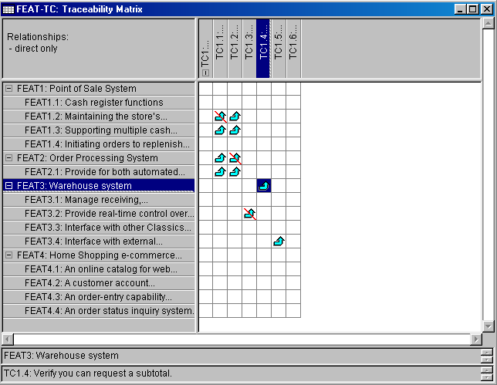
Viewing Links - Traceability Matrix
Notes:
Module 8- Managing Changing Requirements
RMUC Instructor Notes
Here are some ways you might view the traceability links using a requirements management tool, such as Rational’s RequisitePro.
A traceability matrix presents a 2-dimensional view of the traces from one requirement type to another (or to the same) type.

Slide 18
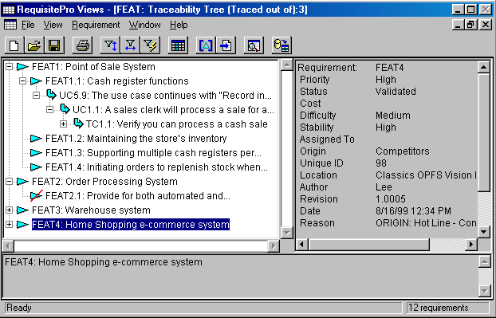
Viewing Links: Tree Report
Tree reports show the full hierarchy of traceability links
Notes:
The Tree view allows you to expand a particular requirement or set of requirements so that you can see its full depth of traceability.
In this example, we are also displaying the selected requirement’s associated attributes that are also contained in the repository (in the right-hand panel).
The Tree view allows you to expand a particular requirement so that you can see its full depth of traceability.
You might also want to point out the associated attributes that are also contained in the repository for each of the requirements (in the right-hand panel).
Mention that students will be able to see more of this during the RequisitePro product training tomorrow, if attending.

Slide 19
Sample Queries Using Requirement Links
Show me all user needs that are not linked to product features
Show me the status of tests on all use cases in Iteration #3
Show me all supplementary requirements linked to tests whose status is untested
Show me the results of all tests that failed, in order of criticality
Show me the features scheduled for this release, which user needs they satisfy, and their status
Notes:
Module 8- Managing Changing Requirements
RMUC Instructor Notes
What types of questions might you ask that could be answered by knowing about the links between the requirements?

Slide 20
Exercise: Establishing Traceability
Look at the initial features for our class project
  Prioritized post-it notes (from brainstorming exercise)
Where does each feature trace into our current use-case model?
What should we do about ones that don’t trace?
Notes:
Look at each of the initial features (from our brainstorming session) for our class project and set up a sample traceability for a few of them through your use-case model.
Look at each of the initial features (from our brainstorming session) for the class project and set up a sample traceability for a few of them through your use-case model.
RECOMMENDED:
Whole-class discussion.
Estimated time: 5-10 minutes.

Slide 21
Exercise: What’s Wrong with this Picture?
FEAT1
FEAT2
FEAT3
Features
Use Cases
UC1
UC2
Supplementary
Requirements
SUPP1
SUPP2
SUPP3
TST1
TST2
TST3
Tests
Implementation
Objects
Notes:
All top-level requirements should trace to a software requirement (either within a use case, a supplementary spec or a formal SRS) and eventually to tests and also to implementation objects.
Run this as a quick class exercise.
Ask: Have you ever seen those children’s puzzles where there is a drawing with things out of place, and the children have fun finding what is wrong with the picture. Like a shoe on top of a house. There used to be a drawing like this every month on the back cover of a magazine called Highlights for Children.
Well what we have here is that kind of a puzzle. What is wrong with this picture?
[Example answer: SUPP3 does not trace from any FEAT. So where did that detailed requirement come from?]
Use this exercise to emphasize how traceability helps you easily discover what requirements have not been implemented and what things in the implementation do not trace back to any requirement.
Then note that the “Tree View” in RequisitePro is exactly the same as the tree in this exercise. By looking at the Tree View, you can discover the requirements that have not been implemented or tested, and the implementation objects that don’t trace back to user needs.
RECOMMENDED:
Whole-class discussion
Estimated time: 5-10 minutes

Slide 22
Change Management
Vision Document
Features
Change
Management
Supplementary Specifications
Software
Requirements
Use-Case Model
Test
Specifications
Design Specifications
User Documentation Specifications
Notes:
By establishing your traceability links, you are able to catch changes wherever they occur and assess the impact both upward and downward on the requirements hierarchy: “Where did this come from?”, “What else does it affect?”

Slide 23
Impact Analysis by Traceability Links
Req A before edit
Req A after edit
“if return value > $5”
“if return value > $2”
Req B
Req B
Req C
Req C
Links to requirements that have changed are marked as “suspect”
Suspect links must be resolved by the user
Notes:
RequisitePro provides what are called “suspect links”, which can notify that an associated requirement has changed.
All directly related requirements should be reviewed to assess whether they are affected.
Why is the link from Req B to Req C not marked as suspect?
The only way to resolve suspect links are manually (by actually looking at the changes and the affected requirements).
RequisitePro provides what are called “suspect links”, which notify that an associated requirement has changed.
All directly related requirements should be reviewed to assess whether they are impacted.
Why is the link from Req B to Req C not marked as suspect? Because it will only go suspect if B actually changes.
The only way to resolve these are manually (by actually looking at the changes and the affected requirements).
You can probably make a *lot* of money if you could figure out a way to do this automatically (joke).

Slide 24
A Key to Managing Change
All requests go through a single channel
Change requests come from many sources throughout each iteration of the product lifecycle
Customer and
End-User inputs
New Feature
Req
Single Channel
for Approval
Marketing
New
Requirement
Design
Approved
Decision
Process
(CCB)
Coders inputs
Testers inputs
Bug
Code
Change
Request (CR)
Test
Help Desk
End-User inputs
Maint
Notes:
Here is the same process that we showed in our scope management unit (control the requirements coming into the project).
We need to continue to follow the same change control process (having all requests go through a single channel) to control changes throughout the product lifecycle.
We are leaving our study of traceability now, and moving on to talk about another key to managing change: all requests go through a single channel of approval.
We have looked at this slide once before, when we talked about establishing scope. The same idea applies to managing changes to scope. It is even more important to have a single channel for approval because there are so many sources for change requests, for example coders, testers, and users of the existing system.

Slide 25
Controlling Requests for Change
Require all changes go through a single channel
Have a documented process for handling change requests
Contents of a change request:
  What artifact or artifacts it concerns
  Problem description
  Suggested solution
  Priority
Should be submitted to a Change Control Board (CCB) or other review authority
Notes:
What should be contained in a Change Control Process?

Slide 26
Requirements Configuration Management
Configuration management of requirements is important for the same reasons that configuration management of source code is important.
Benefits of requirements management under CM
  Prevent unauthorized change
  Preserve revisions of requirements documents
  Retrieve previous versions of documents
  Allow a managed baseline release strategy
  Prevent simultaneous update of documents
Notes:
Module 8- Managing Changing Requirements
RMUC Instructor Notes
It is important to keep track of the change history of requirements and the requirement documents.
It is important to keep track of the change history of requirements and requirement documents.
Tracking change history is done at a requirement-level in RequisitePro, but needs an external application such as Rational ClearCase, VSS or PVCS to keep history of document changes (as far as reproducing previous versions of documents).
Configuration management will be gone into more in the RequisitePro training. Try not to get pulled into discussing the tool aspects too much or you will not have time to cover all the subjects. You may defer most of the tool discussions to the RequisitePro training session.

Slide 27
Managing Changing Baselines
When do you “Freeze” the specification???
Notes:
Module 8- Managing Changing Requirements
RMUC Instructor Notes
Do you “freeze” your requirements specifications? If so, when? What does this mean?
Story about California lawsuit. Vendor delivers code to letter of specification. Customer ignores delivery and refuses to pay. Vendor sues. Deal settles in favor of customer. Theory is the unreasonableness of specifying the exact specs three years earlier.
How much do you allow the specifications to change?
Two extremes:
Freeze the spec at the end of the requirements phase (of a waterfall method) and don’t allow any changes. The problem with this extreme is that it probably won’t be at all feasible.
Never freeze the spec and allow changes up until when you deliver. The problem with this extreme is that it is difficult to assure quality if you never have a solid baseline against which to test.
Best option is somewhere in between: freeze late enough to allow the customer reasonable changes, yet early enough to assure that the product is adequately tested before it is shipped.
An iterative approach helps with this problem since the scope of the specification can be reviewed during the iteration assessment at the end of each iteration.

Slide 28
Structuring the Use-Case Model
What is “structuring”?
  Factoring out parts of use cases to make new use cases
Why structure the use-case model?
  Simplify the original use cases
    Make easier to understand
    Make easier to maintain
  Reuse behavior
    Share among many use cases
Notes:
Structuring the use-case model can help us handle changing requirements, such as added functionality or isolating changes to a particular requirement.
It is important not to start structuring the use-case model until we have a set of requirements the user understands and agrees to. At this point, we will discuss some of the structuring techniques that may be used in later iterations of use-case-model definition.
Make sure you do not start these too early, or you may confuse the customer (or yourself!).
Here we are moving on to a new section of this module: structuring the use-case model. It is really RE-structuring since the use-case model already has a structure before you begin the “structuring” activity. But the RUP terminology is just “structuring”.
Emphasize that you don’t want to begin structuring until the customer and developers have identified and approved the details of almost all use cases. And even then, don’t re-structure very much, since it adds complexity to the model (more use cases, more relationships between use cases).
Structuring is available for situations that really need it, but should not be overused.

Slide 29
Use-Case Relationships
Include
Extend
Generalization
<<include>>
Base
<<extend>>
Handout
WP: Structuring the Use Case Model
Notes:
The purpose of structuring the use-case model is to extract behavior from one use case that can better be represented in a separate use case. Examples of behavior to factor out are: common behavior, optional behavior, exceptional behavior, and behavior that is to be developed in later iterations.
To structure the use cases, we have three different kinds of relationships:
The include-relationship
The extend-relationship
The generalization relationship
The use case that represents the modification we will call the addition use case. The original use case that is modified we will call the base use case.
We will give definitions and examples of each type of relationship on the following slides.
For reference and for further information, see the white paper Structuring the Use-Case Model located in the Handouts.
These are the three types of use-case relationships that exist in UML 1.3. Point out the UML symbols for each relationship in the drawing on the right. The open-headed arrow without a label is the UML symbol for generalization.
Note the term “base” use case. The base use case is the original use case from which behavior is factored out. The use case that represents the modification is the “addition” use case.
If students ask, you may want to mention that in UML 1.1, these relationships were somewhat different. It is worth mentioning because students will see the UML 1.1 relationships in books such as UML Distilled, by Martin Fowler. In UML 1.1, the include relationship was called “uses”, the extend relationship was called “extends”, and generalization of use cases did not exist.
We will give definitions and examples of each type of relationship on the following slides.

Slide 30
What Is an Include Relationship?
An include-relationship is a relationship from a base use case to an inclusion use case
The behavior defined in the inclusion use case is explicitly inserted into the base use case
Inclusion
<<include>>
Base
Notes:
The include-relationship connects a base use case to an inclusion use case. The inclusion use case describes a behavior segment that is inserted into a use-case instance that is executing the base use case. The base use case explicitly includes the inclusion use case. The base use case can depend on the result of performing the inclusion, but neither the base nor the inclusion may access each other's attributes. The inclusion in this sense is encapsulated, and represents behavior that can be reused in different base use cases.

Slide 31
Include Relationship: ATM Example
Handout
Identify Customer
UC4: Use-Case Model Structure
<<include>>
<<include>>
<<include>>
Withdraw Cash
Transfer Funds
Deposit Cash
ATM Customer
Withdraw Cash Use Case
1. Include “Identify Customer” to verify customer’s identity
2. Display options. Customer selects “withdraw cash”
3. ...
Identify Customer Use Case
1. Insert card
2. Validate card
3. Enter PIN
4. Verify PIN
A1: Not valid Card
A2: Wrong PIN
A3: ...
Notes:
In this example, the Identify Customer Use Case contains all of the behavior that involves inserting and validating the ATM card and PIN. This behavior can then be extracted from all of the use cases that require customer identification, such as: Withdraw Cash, Transfer Funds, and Deposit Cash. Each of these use cases now simply <<include>> the new use case, Identify Customer.
Explain the example: the include relationship, the diagram, and the text.
Ask: What are some advantages to factoring out the behavior of identifying a customer into a separate use case?
Ask: What are some disadvantages?
The full example is located in UC4 in the Student Handouts. If you have time, bring the full example up on your screen and walk the students through it.
Note also that this example is just for teaching purposes. All of the use cases have been simplified from what they would be in “real life”.

Slide 32
Why Use An Include Relationship?
  Factor out behavior common to two or more use cases
    Avoid describing same behavior multiple times
    Assure common behavior remains consistent
  Factor out and encapsulate behavior from a base use case
    Simplify complex flow of events
    Factor out behavior not part of primary purpose
Inclusion
<<include>>
Base
Notes:
If several uses cases share the same behavior, then you can factor out the shared behavior into an inclusion use case.
If a part of a base use case represents a function of which the use case only depends on the result, (and not the method used to produce the result), you can factor that part out to an addition use case. The addition is explicitly inserted in the base use case, using the include-relationship.

Slide 33
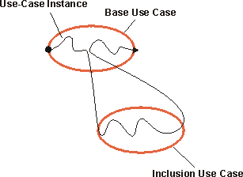
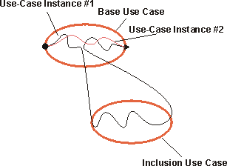
Executing Include
An included use case is fully
executed whenever the inclusion
point is reached
If bypassed, control is in the base use case
Notes:
The behavior of the inclusion is inserted in one location in the base use case. When a use-case instance following the description of a base use case reaches a location in the base use case from which include-relationship is defined, it will instead follow the description of the inclusion use case. Once the inclusion is performed, the use-case instance will resume where it left off in the base use case.
The include-relationship is not conditional. If a use-case instance reaches the location of the “include” statement in the base use case, the included use case will always be executed. Bur if a use-case instance never reaches the location in the base use case where the include-relationship is defined, the included use case will not be executed.
If you want to express a condition that only sometimes includes a use case, you need to do that as part of the “include” statement the base use case.

Slide 34
What Is An Extend Relationship?
An extend-relationship is a relationship from an extension use case to a base use case
  Insert extension use case’s behavior into base use case
  Insert only if the extending condition is true
  Insert into base use case at named extension point
Base
<<extend>>
Extension
Notes:
The extend-relationship connects an extension use case to a base use case. You define where in the base use case to insert the extension by placing a reference in the extending use case to a named extension point in the base use case. The extension use case can often be abstract, but it doesn’t necessarily have to be.

Slide 35
Extend Relationship: ATM Example
Handout
UC4: Use-Case Model Structure
Withdraw Cash
ATM Customer
<<extend>>
<<extend>>
Withdraw Coins
Withdraw stamps
Withdraw Coins and Withdraw Stamps Use Cases both <<extend>> the Withdraw Cash Use Case
Notes:
In this example, the behavior for withdrawing coins has been factored out into its own use case. The behavior for withdrawing cash in the form of stamps has also been factored out into its own use case. Both the Withdraw Coins Use Case and Withdraw Stamps Use Case <<extend>> the Withdraw Cash Use Case.
Explain the example: the include relationship, the diagram, and the text.
Note that we could have included the “withdraw coins” behavior as an alternative flow within the base use case, Withdraw Cash. But we chose to make it a separate use case instead.
Ask: What are some advantages to factoring out the behavior of withdrawing coins into a separate use case?
Ask: What are some disadvantages?
The textual example is located on the next slide.
The full example of “Withdraw Coins” is located in UC4 in the Student Handouts. If you have time, bring the full example up on your screen and walk the students through it.
Note also that this example is just for teaching purposes. All of the use cases have been simplified from what they would be in “real life”.

Slide 36
Extend Relationship: ATM Example (cont.)
Withdraw Coins Use Case
This use case is an extension of the Withdraw Cash Use Case, at the extension point “Alternate Fund Withdrawals”.
Basic Flow:
1. If ATM Customer selects “coins”, the Customer then specifies the kind and number of coin rolls.
2. Calculate total withdrawal.
3. ATM Customer commits.
4. Rolls of coins are dispensed.
5. The Withdraw Cash Use Case continues.
A1: Out of coins
A2: Coin roll stuck
A3: ...
Withdraw Cash Use Case
Basic Flow:
1. Include “Identify Customer” to verify customer’s identity.
2. Display options. Customer selects “withdraw cash”.
3. Enter account and amount.
4. Send transaction to Bank Consortium. Get approval.
5. Display options. The ATM dispenses cash.
6. Return Bank Card.
7. Print receipt.
Extension Points:
1. Alternate Fund Withdrawals
This extension point occurs in place of Step 5 in the Basic Flow.
Notes:
In this example, the Withdraw Coins Use Case extends the Withdraw Cash Use case.
The extension point “Alternate Funds Withdrawal” in the base use case tells where the Withdraw Coins Use Case extension is performed.
The Withdraw Coins Use Case is only performed if the condition “Bank Customer selects COINS” is true.
Note that more than one use case can be attached at an extension point. In this example, it makes sense to attach both the Withdraw Coins Use Case and the Withdraw Stamps Use Case at the extension point “Alternate Funds Withdrawal” in the base use case Withdraw Cash.
Discuss the Withdraw Coins Use Case example. Be sure to point out the main parts of the extension relationship:
The definition of the extension point in the base use case
The reference to the extension point in the extending use case that tells where to attach the extension in the base use case
The condition in the extending use case that controls whether the extension occurs

Slide 37
Why Use an Extend Relationship?
Factor out optional or exceptional behavior
  Executed only under certain conditions
  Factoring out simplifies flow of events in base use case
  Example: Triggering an alarm
Add extending behavior
  Behavior developed separately, possibly in later version
  Example: Make Phone Call UC
Base
<<extend>>
Extension
Notes:
If there is a part of a base use case that is optional, or not necessary to understand the primary purpose of the use case, you can factor that part out to an addition use case in order to simplify the structure of the base use case. The addition is implicitly inserted in the base use case, using the extend-relationship.
The extension is conditional, which means its execution is dependent on what has happened while executing the base use case. The base use case does not control the conditions for the execution of the extension. Those conditions are described within the extend-relationship. The extension use case may access and modify attributes of the base use case. The base use case, however, cannot see the extensions and may not access their attributes.
The base use case is implicitly modified by the extensions. You can also say that the base use case defines a framework into which extensions can be added, but the base does not have any visibility of the specific extensions.
The base use case should be complete in and of itself, meaning that it should be understandable and meaningful without any references to the extensions. However, the base use case is not independent of the extensions, since it cannot be executed without the possibility of following the extensions.
Explain the main reasons to use an extend relationship.
Discuss the Make Phone Call example.
Ask: What functionality has been added to making a phone call in recent years? [call waiting, call forwarding, etc.]
Note that call waiting and call forwarding could be added as alternative flows to the existing Make Phone Call Use Case.
Ask: Why might it be a good idea to make them their own use cases? [Make Phone Call Use Case is probably already too big. Make Phone Call Use Case is already finished, and we don’t want to re-do it. Call Waiting is optional, separate from rest of Make Phone Call, and also big.]
Representing the optional behaviors as extension use cases is a correct use of the extend-relationship, since the base use case, Make Phone Call, is meaningful in itself. You do not need to read the descriptions of the extension use cases to understand the primary purpose of the base use case, since the extension use cases are optional.
Ask: What would the condition be for executing the Call Waiting Use Case if it is an extension to the Make Phone Call Use Case? [The callee phone is busy and callee has call waiting installed and voice mail box is not full.]

Slide 38
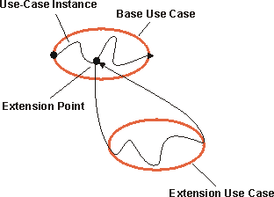
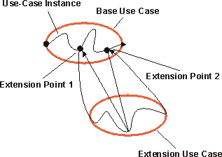
Executing Extend
A use-case instance following a
base use case and its extension
A use case may have multiple insertion segments
Notes:
When a use-case instance performing the base use case reaches a location in which the base use case has an extension point defined for it, the condition on the corresponding extend-relationship is evaluated. If the condition is true or it is absent, the use-case instance will follow the extension (or the insertion segment within it that corresponds to the extension point). If the condition of the extend-relationship is false, the extension is not executed.
The extension use case may, just like any use case, have a basic flow of events and alternative flows of events. Which exact path the use-case instance will take through the extension will depend on what has happened before in the execution (the state of the use-case instance) and what happened in interaction with the actors as the extension is executed. Once the use-case instance has performed the extension, the use-case instance resumes executing the base use case at the point where it left off.

Slide 39
What Is Use-Case Generalization?
Use-case generalization is a relationship from a child use case to a parent use case
  Describe general shared behavior in parent
  Describe specialized behavior in children
Parent
Child
Child
Notes:
A parent use case may be specialized into one or more child use cases that represent more specific forms of the parent. Neither parent nor child is necessarily abstract, although the parent in most cases is abstract. A child inherits all structure, behavior, and relationships of the parent. Children of the same parent are all specializations of the parent. This is generalization as applicable to use cases.
Note the direction (and open-head arrow) of generalization arrow!
Explain use use-case generalization.
Note direction (and open-head arrow) of generalization arrow!

Slide 40
Generalization: ATM Example
Parent is Identify Customer Use Case
Children are Check Password and Scan Retina
  Children specialize part of the parent behavior
Identify Customer
Check Password
Scan Retina
Notes:
In this example from the ATM, the parent is the Identify Customer Use Case. In its most general form it consists of steps to have the ATM customer enter a card and verify the identity of the person inserting the card. But, there may be different ways that a customer’s identity is verified. The Check Password Use Case is a child of the Identify Customer Use Case, in which the customer is identified by entering a password. The Scan Retina Use Case is another child of the Identify Customer Use Case, in which the customer is identified by having his/her eye scanned. Each child contains the special behavior that modifies the parent.
This example is adapted from an example in The Unified Modeling Language Reference Manual, by Rumbaugh, Jacobson and Booch. It is an example for illustrative purpose only. Since activities like checking a password involve very little specification, it is probably too simple to be a separate use case in a real application.

Slide 41
Why Use Use-Case Generalization?
Generalization shows common behavior, structure, and purpose in two or more use cases
  Show that children are part of a family of use cases
  Avoid describing same behavior multiple times
  Assure common behavior remains consistent
Parent
Child
Child
Notes:
Generalization is used when you find two or more use cases that have commonalities in behavior, structure, and purpose. In such a case, you can describe the shared parts in a new, often abstract, use case that is then specialized by child use cases. The parent use case may consist of both behavior and characteristics that are shared.
Experience in the field suggests that generalization is rarely used in actual practice. Instead, the specialized behavior is modeled with alternative flows inside the base use case.
Explain why you might use use-case generalization.
Note: This association should not be used very often. Experience in the field suggests that generalization is rarely used in actual practice. Instead, the specialized behavior is modeled with alternative flows inside the base use case.

Slide 42
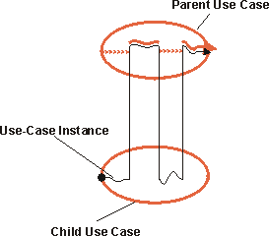
Executing Use-Case Generalization
A use-case instance executing a child use case will follow the flow of events described for the parent use case, inserting additional behavior and modifying behavior as defined in the flow of events of the child use case
Notes:
A use-case instance executing a child use case will follow the flow of events described for the parent use case by inserting additional behavior and modifying behavior as defined in the flow of events of the child use case.
In general, you do not have to describe the generalization-relationship itself. Instead, in the flow of events of the child use case, you will specify how new steps are inserted into the inherited behavior and how inherited behavior is modified.
If the child is specializing more than one parent (multiple inheritance), you must in the specification of the child explicitly state how the behavior sequences from the parents are interleaved in the child.

Slide 43
Concrete vs. Abstract Use Cases
A use case is either concrete or abstract.
Abstract use cases (A & D):
  Do not have to be complete.
  Exist only for other use cases.
  Are never instantiated on their own.
A
«include»
Hint:
Cover up all abstract use cases and you should still be able to understand the main purpose of the system.
B
C
«extend»
Concrete use cases (B & C):
  Have to be complete and meaningful.
  Can be instantiated on their own.
D
Notes:
When you extract behavior into a used or extending use case, these new use cases are most often the kind that will never be executed stand alone; they always exist as a part of another use case. So they are abstract use cases.
But:
A concrete use case can use another concrete use case!
A concrete use case can be extended by a concrete use case!
You may want to avoid this confusion by having guidelines that state that all extending and used use cases will be abstract.
Explain the concepts of abstract and concrete use cases. Which ones can the actor actually do?
The most important thing to note on this slide is the Hint!

Slide 44
What Is Actor-Generalization?
Actors may have common characteristics
Multiple actors may have common roles or purposes interacting with a use case
Parent
Child
Child
Notes:
A user can play several roles in relation to the system, which means that the user may, in fact, correspond to several actors. To make the model clearer, you can represent relationships among actors. The shared role is modeled as a parent actor. The children actors inherit the common roles of the parent.
A parent actor may be specialized into one or more child actors that represent more specific forms of the parent. Neither parent nor child is necessarily abstract, although the parent in most cases is abstract. A child inherits all of the relationships of the parent. Children of the same parent are all specializations of the parent. This is generalization as applicable to actors.
We give a specific example on the following page.
Note direction (and open-head arrow) of generalization arrow!

Slide 45
Actor Generalization: Hospital Example
Parent: Medical Worker
  Medical Worker can read charts
Children: Doctor, Nurse, Aide
  Doctor, Nurse, and Aide can read charts
Doctor
Read Chart
Nurse
Medical Worker
Aide
Notes:
Explain this example, using the Student Notes.
Note: We could not think of a meaningful example of actor generalization for the ATM example. To make good use of actor-generalization, you need a much richer set of actors than we have in the ATM example.
So, we switched for this one example to a Hospital Record Keeping System. This example is adapted from a real application.
The child actors could be further specialized. For example, Doctors can be Surgeons, General Practitioners, or Radiologists. Each of these types of Doctor actors may have specific use cases that only they can perform.
There are very few instances where actor-generalization is used in practical experience.
There are many actors (roles) that interact with a hospital record-keeping system, including doctors, nurses, and aides. Some use cases can be done by many actors. For example, there may be 10 different actors in a hospital who can all read patient charts. We could have 10 communicates-associations (represented by 10 lines) between each of the 10 actors and the Read Chart Use Case. Or, we could simplify by defining all 10 actors as children of a parent actor called Medical Worker. Then, we only draw a single communicates-association between the Medical Worker and the Read Chart Use Case. All of the child actors, such as doctors, nurses, and aides, inherit the capability to do the Read Chart Use Case.
The medical worker actor could participate in lots of other use cases, such as the Ring for Security Use Case and Record Temperature on Chart Use Case. The child actors, such as doctors, nurses, and aides, would inherit the capability to do the all of these use cases.
Why even have the child actors? Well, each actor (role) can participate in some other use cases that the other actors cannot. For example, only Doctor actors can perform the Schedule Surgery Use Case. So, we draw a communicates-association between the Doctor actor and the Schedule Surgery Use Case. We cannot draw a communicates-association between the Medical Worker actor and the Schedule Surgery Use Case because the other children of the medical worker (such as nurses and aides) cannot perform the Schedule Surgery Use Case.

Slide 46
Why Use Actor-Generalization?
To simplify associations between many actors and a use case
To show that an instance of a child can perform all behavior described for the parent
Parent
Child
Child
Notes:
This association should not be used very often. Remember that our primary goal is to model the system, not its surroundings!
Ask: “Are we modeling inside the system?” (no)
Note: This association should not be used very often. Remember that our primary goal is to model the system, not its surroundings!
Note direction (and open-head arrow) of generalization arrow.

Slide 47
Abstract versus Concrete Actors
An abstract actor contains the common part of the roles
  It cannot be instantiated itself
  Example: No person is hired to be a Medical Worker
A concrete actor can be instantiated
  Example:
    Loren is a Doctor
    Pat is a Nurse
Medical
Worker
Doctor
Nurse
Notes:
Compares to class inheritance.

Slide 48
Use-Case-Modeling Guidelines
The Use-Case-Modeling Guidelines should include:
  Notations to use and not use. For example, whether to use generalization-relationships
  Rules, recommendations and style issues, and how to describe each use case
  Recommendations for when to start structuring the use cases (not too early!)
Notes:
Here is a proposed outline of a Use-Case-Modeling Guidelines document:
1. Brief Description:
A brief description of the role and purpose of the Use-Case-Modeling Guidelines.
2. References:
A description of related or referenced documents.
3. General Use-Case-Modeling Guidelines:
Th-s section describes which notation to use in the use-case model. For example, you may have decided not to use extends-relationships between use cases.
4. How to Describe a Use Case:
This section gives rules, recommendations and style issues, and how you should describe each use case.
The Use-Case-Modeling Guidelines are the place to record your decisions about use-case style and modeling rules.
Stress that structuring should *not* be done too early in the lifecycle. In fact, it may not have to be done at all -- and for beginning users it should be discouraged.
The Use-Case-Modeling Guidelines can help enforce the idea that structuring should *not* be done too early in the lifecycle.
Only begin structuring *after* the users have understood and agreed to the basic use cases.

Slide 49
Exercise: Structuring the Use-Case Model
Look at your model of your class project and discuss whether you should structure it using use case or actor generalizations, include- or extend-relationships.
Notes:
RECOMMENDED:
Whole-class discussion.
Estimated time: 5 minutes

Slide 50

Review: Relationships in the Use-Case Model
to
from
generalization
communicates
<<include>>
<<extend>>
generalization
communicates
Notes:
This slide is animated (on mouse click) to bring in each of the different types of relationships one-at-a-time, so they can be discussed individually.

Slide 51
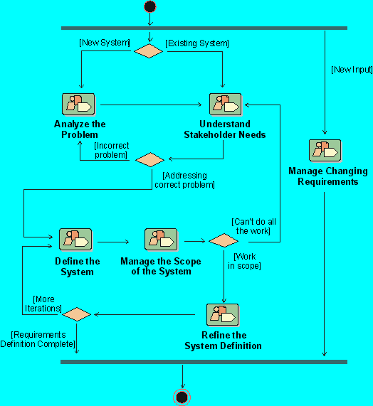
Workflow Detail: Manage Changing Requirements
Notes:
Where does Managing Changing Requirements workflow detail fit in the development process.
The workflow detail called “Manage Changing Requirements” in the Rational Unified Process represent activities we might undertake to help us manage change throughout the lifecycle of our system’s development.
Where is this done in your own software development process?
If presenting this course on-site at a company not using RUP, discuss the activities they use to accomplish this objective.

Slide 52
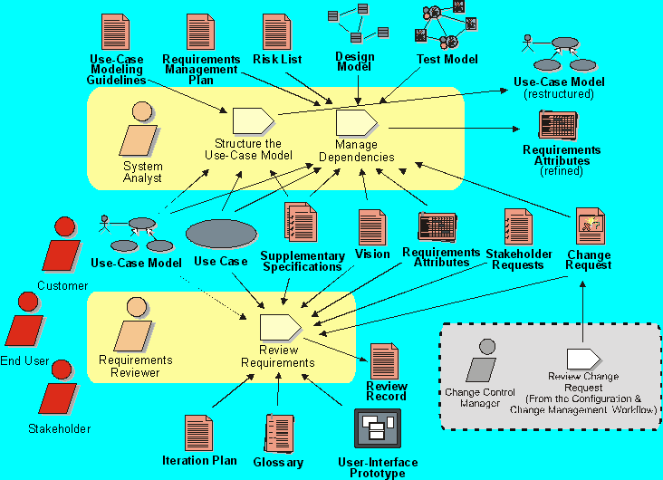
Workflow Detail: Manage Changing Requirements
Notes:
The purpose of this workflow detail is to:
Evaluate formally submitted change requests and determine their impact on the existing requirement set
Structure the use-case model
Set up appropriate requirements attributes and traceabilities
Formally verify that the results of the Requirements workflow conform to the customer's view of the system
Changes to requirements naturally influence the models produced in the Analysis & Design workflow, as well as the test model created as part of the test workflow. Traceability relationships between the requirements identified in the manage dependency activity of this workflow and others is the key to understanding these effects.
Another important concept is the tracking of requirement history. By capturing the nature and rationale of requirement changes, reviewers (in this case the role is played by anyone on the software project team whose work is affected by the change) receive the information needed to respond to the change properly.

Slide 53
Review: Managing Changing Requirements
1. What are some reasons requirements change?
2. What is most important when setting up a change process?
3. When do you “freeze” the product specifications?
4. What are some benefits of maintaining all requirements in a central repository?
5. How is requirements traceability helpful in managing change?
  How is traceability used in impact analysis?
  What levels of traceability should be used in your project?
  What is a “suspect link”? How should it be handled?
6. What are some benefits of keeping your requirements under configuration management?
(continued→)
Notes:
Use these questions to monitor the students’ level of understanding and to help them review.
Tell them they can look back through the material to get the answers.
Give them time to answer. Don’t be afraid to stand quietly while they look up the answer.

Slide 54
Review: Managing Changing Requirements (cont.)
7. Why might you decide to structure your use-case model?
8. What types of relationships exist between actors? Between use cases?
9. When do you use an extend-relationship?
10. When do you use an include-relationship?
11. When might you decide to use generalizations of use cases?
12. What is an abstract actor? A concrete actor?
13. What is an abstract use case? A concrete use case?

